Slide 1

Medieval Fantasy
João Gaspar, 107708
Introduction to Computer Graphics – 2023/2024 – Project 1

Slide 2
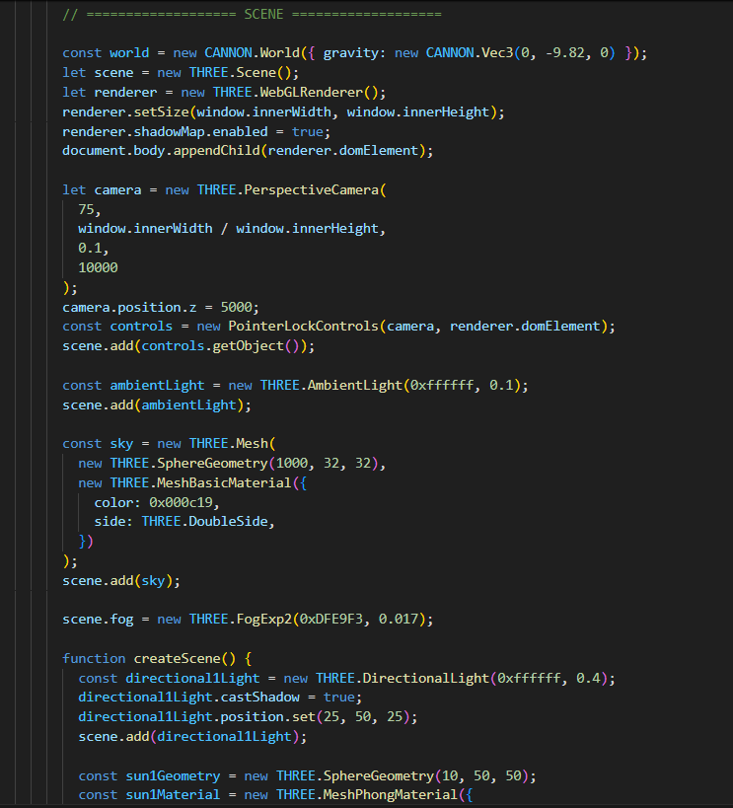
Main Idea
Create an medieval environment and allow the user to explore it and fight against enemies withing the setting.
It will use three.js and some Blender modules.
The demo is available at joaogasparp.github.io and the code at https://github.com/joaogasparp/joaogasparp.github.io

Slide 3
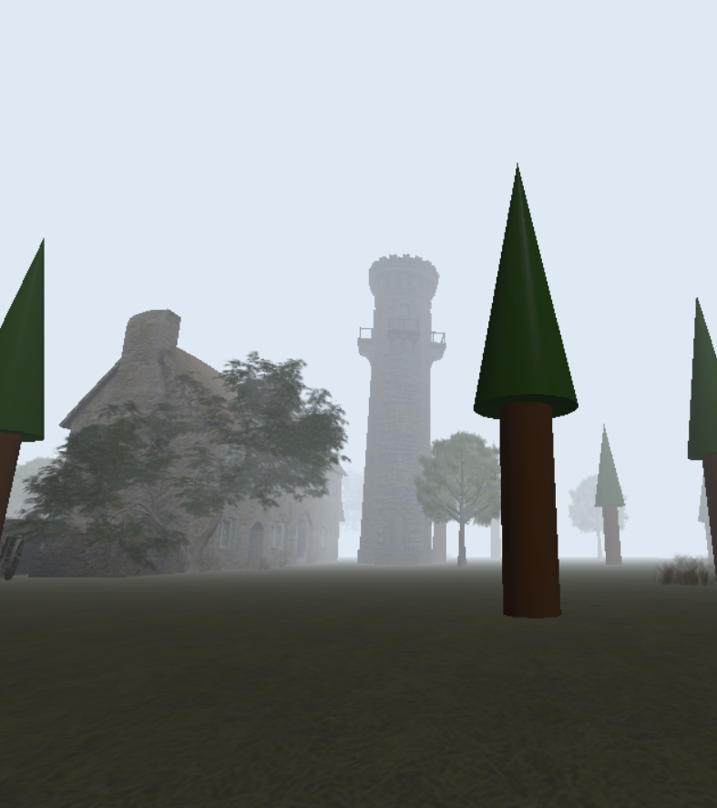
What is Done
The environment contains models reminiscente of a medieval era.
The user can freely move around the map.

Slide 4
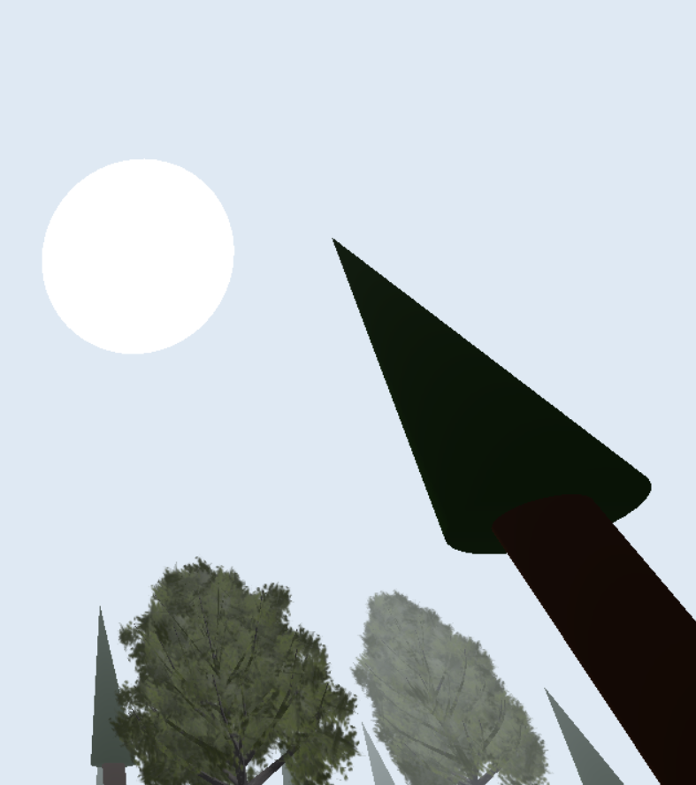
Models and Illumination
There are various models, made both using three.js (by me) and Blender, such as:
Fog (three.js)
Sun (three.js)
Trees (three.js and blender)
Grass (Blender)
House (Blender)
Regarding illumination, there is an Ambient Light and a Directional Light.

Slide 5
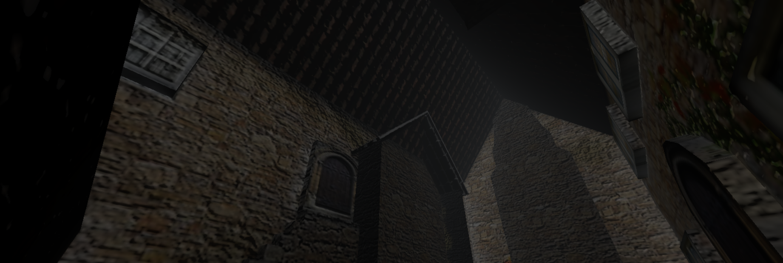
User Interaction and Problems while working
The user can use "WASD" and the space bar to move freely around the map.
Issues with performance, adding collisions, and shadows.

Slide 6
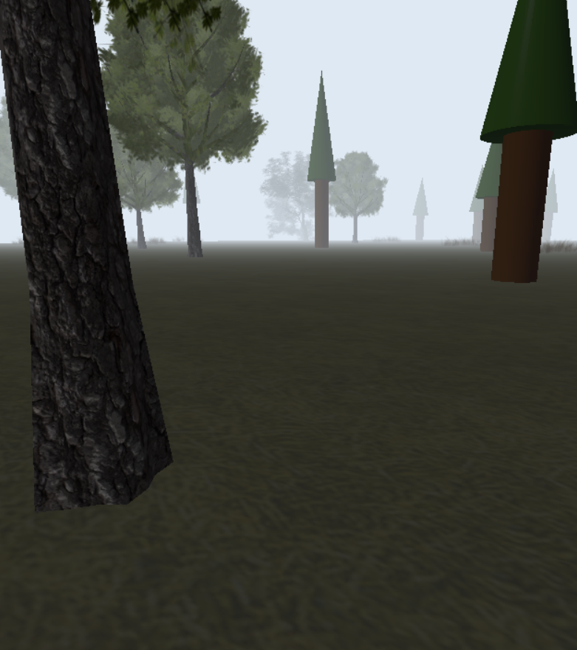
Next Steps
Add shadows and collisions to the models.
Add enemies and a way to fight them.

Slide 7
References
Sketchfab. (n.d.-b). Sketchfab. https://sketchfab.com/search?features=downloadable&type=models
“Make a Grass in 45 Seconds-Blender 2024.” Www.youtube.com, www.youtube.com/watch?v=xX72ZuCOVVE&ab_channel=BlenderTips. Accessed 10 Apr. 2024.
Fog – three.js docs. https://threejs.org/docs/#api/en/scenes/Fog
Loading 3D models – three.js docs. https://threejs.org/docs/#manual/en/introduction/Loading-3D-models

